Slide 1

Lecture 1: Managers and
Organizations Today
By Alisher Ismailov
2023-2024 Academic Year

Slide 2

About me
Alisher Ismailov – Course Leader for Business Management and its Pathways
Module Leader for Introduction to Management and Organizational Behaviour
Module Leader for New Venture Creation
Owner of two businesses
Volkswagen Uzbekistan Product Manager
Official Partner of Hyundai Auto Asia
Official Partner of BYD Uzbeksitan
Official Partner of TBC Bank
Automotive Expert recognized by UzAuto Motors
Business Consultant
Business experience of 10 years globally
Office in ATB201, email: a.ismailov@wiut.uz

Slide 3



Module Description
Title: Introduction to Management and Organsational Behaviour
Module Code: 4MNST001C-n
Length: Year long (2 semesters)
Status: Core
Credit Value: 20 credits
Pre-requisites: None

Slide 4


Assessment
Component 1: Presentation
When: Semester 1
Weighting: 30%
Length: 5-6 min
LOs Covered: 1,3
Component 2: Group CW
When: Semester 2
Weighting: 30%
LOs Covered: 1,2
Component 3: Final Exam
When: Semester 2
Length: 2 hours 15 mins.
LOs Covered: 1-4

Slide 5

Do not miss important announcements!
Link to IMOB Telegram channel
If you cannot scan, direct link is:
https://t.me/imob2324

Slide 6

Do’s and Don’ts During Lectures

Slide 7
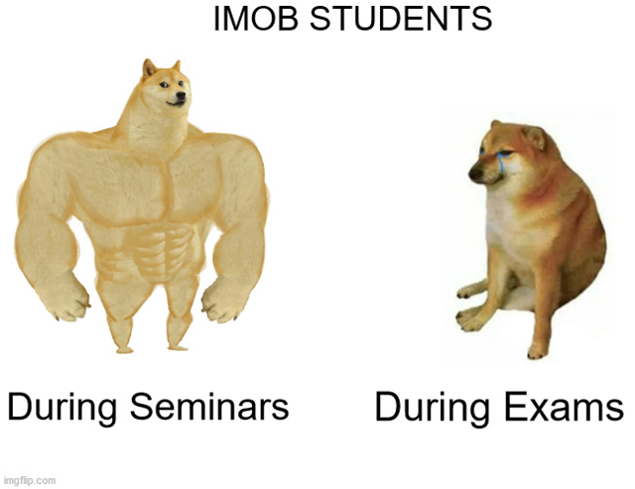

Slide 8

What is Management?

Slide 9

Management Definition
Management – the organization that embraces the decisions and actions involved in bringing people and other resources together to achieve some purpose

Slide 10

Organization: Definition
Organization – A collection of people working together to achieve a common purpose
The purpose of any organization is to provide useful goods and/or services that return value to society and satisfy customer needs in order to justify continued existence

Slide 11

Manager: Definition
A manager is a person who supports and is responsible for the work of others

Slide 12
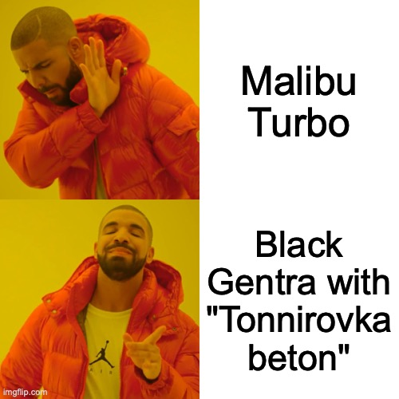
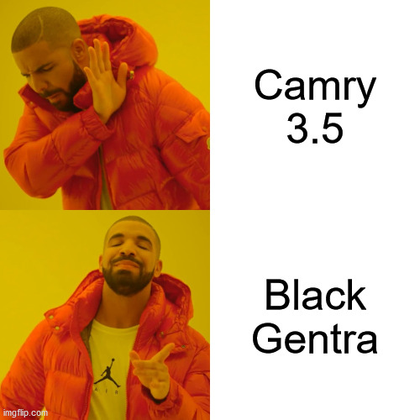
Real manager’s choice
With “tonnirovka beton”

Slide 13

But you might have a question: What are the roles of manager and what does he/she do?

Slide 14
Managerial Roles
Roles – The expected behaviors and performance results associated with a particular person
Fayol’s description of the manager’s roles
Mintzberg’s managerial roles

Slide 15
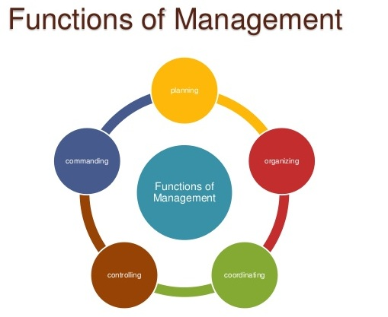
Fayol’s Description
Roles of a MANAGER:
Planning
What we want to accomplish
How we accomplish it
Setting strategies and goals
Developing action plan for implementation
Organizing
What resources do we have
What resources can help us achieve our strategies and goals
Links between people and resources

Slide 16
Fayol’s Description
Roles of a MANAGER:
Commanding
How do we influence the behavior of all the individuals and groups involved
How do we achieve synergy
Coordinating
How do we adjust the activities to individual groups
How do we ensure harmony
Controlling
What are the goals and standards
What is our actual performance
Any corrections that we need to make

Slide 17
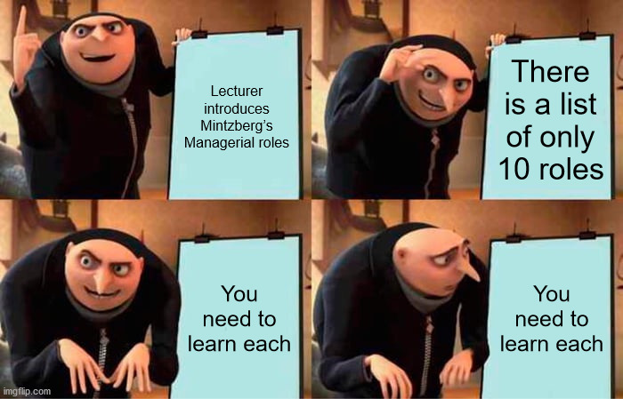
Mintzberg’s Managerial roles
The ten roles are:
Figurehead.
Leader.
Liaison.
Monitor.
Disseminator.
Spokesperson.
Entrepreneur.
Disturbance Handler.
Resource Allocator.
Negotiator.

Slide 18
Mintzberg’s Managerial roles
The 10 roles are then divided up into three categories, as follows:
Category | Roles
Interpersonal | Figurehead Leader Liaison
Informational | Monitor Disseminator Spokesperson
Decisional | Entrepreneur Disturbance Handler Resource Allocator Negotiator

Slide 19
Interpersonal Roles
Interpersonal Roles are those requiring managers to deal with people
Figurehead – as a head of organization managers performs “ceremonial duties”
Leader – Inspires people to fulfill unit’s purpose. Provides vision. Makes sure employees needs are met
Liason – contacts people outside vertical chain of command. Builds network relationships that serve his agenda

Slide 20
Informational Roles
Informational roles are those through which a manager processes information and communicates it to others
Monitor – gathers information from a network of contacts. Anything from gossips to formal written reports
Disseminator – Being in the center has access to more info. Shares and distributes it to others
Spokesman – sends information outside his work unit. Both internal and external stakeholders

Slide 21
Decisional Roles
Decisional roles are those through which a manager guides the strategy and courses of action of the unit
Entrepreneur – Looks out for new ideas. Adapts to changing conditions. Proposes new projects. Acts as initiator of change.
Disturbance handler – Responds to pressures and problems. Handles conflicts.
Resource allocator – Who gets what. Both long and short term allocations.
Negotiator – Balances individual needs by negotiating solutions between opposed parties

Slide 22
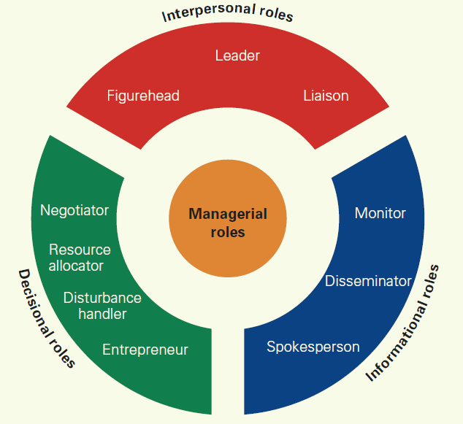
Mintzberg’s Managerial Roles

Slide 23
Glossary
Division of labor – the dividing up of work into individual tasks that, when brought together in a coordinated fashion, help the organization achieve its overall goals
Specialization – The act of specifying work tasks when the organization puts into practice division of labor
Departmentalization – The organization of work groups according to some commonality, such as function of product group
Hierarchy – The structure of superior and subordinate reporting relationships in an organization

Slide 24
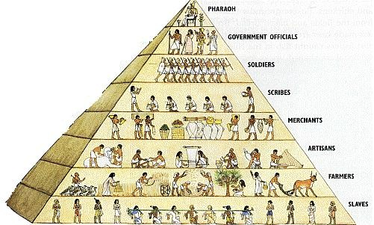
Types of Managerial Positions

Slide 25

Functional VS. General
Functional manager – a classification of managers who take responsibility for one type of specialized activity or function, such as marketing, finance, R&D, manufacturing of distribution
General Manager – the classification of managers who take responsibility for all or part of the organizations, such as division, a plant, a subsidiary, a hospital, or a government agency and have top authority for most specialized activities or functions

Slide 26
Manager Skills
Conceptual skills – the ability to think analytically and achieve integrative problem solving
Human skills – the ability to work well with other people. emotional intelligence – the ability to manage ourselves and relationships effectively
Technical skills – the ability to perform a special task with proficiency

Slide 27
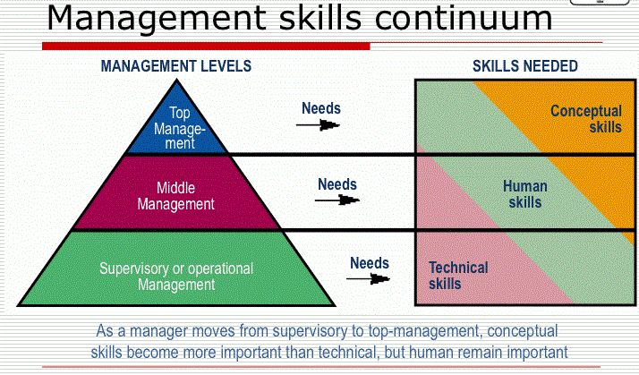
Manager Skills

Slide 28

Questions

Slide 29
Reading
Bounds, Gregory M, Gregory H Dobbins, and Oscar S Fowler. Management . A total quality perspective. Cincinnati, Ohio: South-Western College Pub., 1995. Print.
Schermerhorn, John R. Exploring Management. 3Rd Ed. Print
Mullins, L. (2002), Management and Organisational Behaviour, 6th edition, Harlow: Pearson Education Limited
Greenberg, J. & Baron, R.A. (2000), Behaviour in Organisations, Prentice Hall
Grint, K. (1998), The Sociology of Work: An Introduction, Polity Press/Blackwell
Robbins, S. (2001), Organizational Behaviour (9th Edition). Englewood Cliffs, NJ: PrenticeHa

